Slide 1


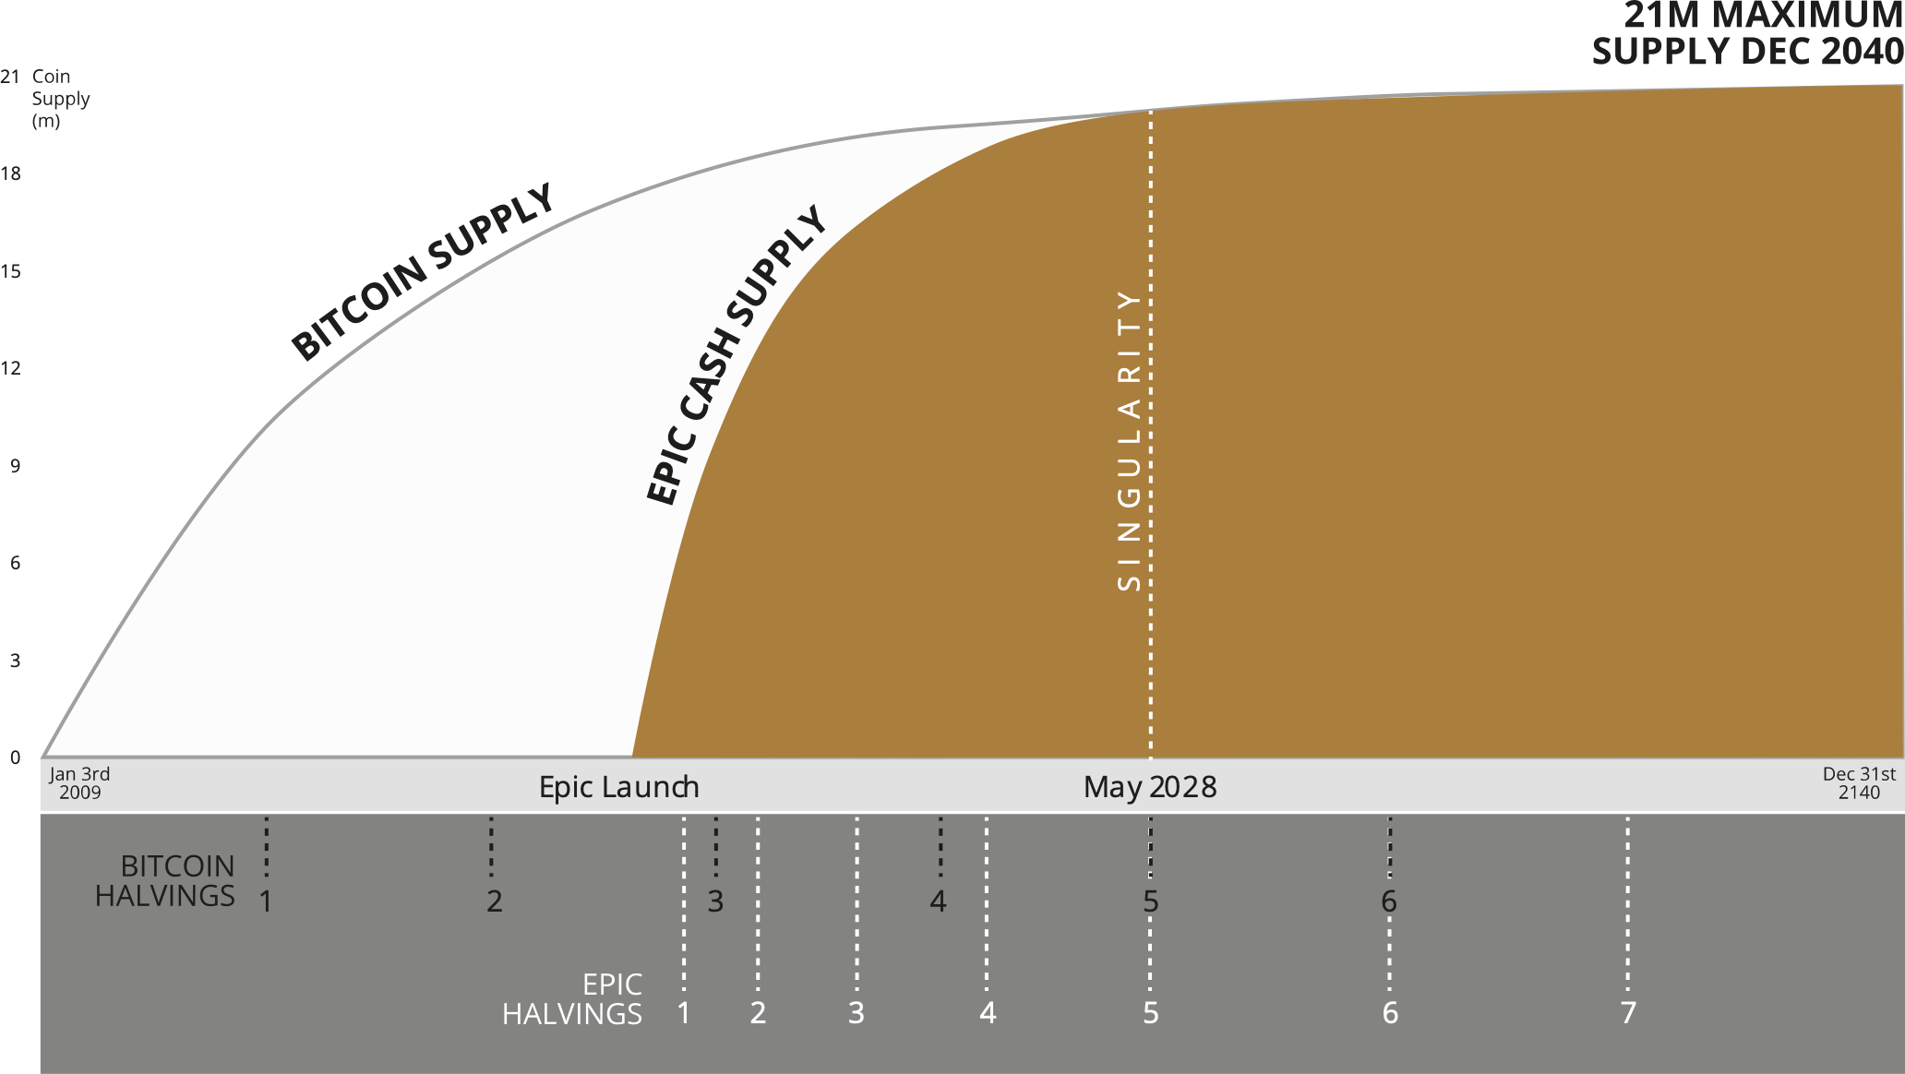






WHY EPIC?
BITCOIN STANDARD EMISSIONS
21M MAXIMUM SUPPLY DEC 2140
Limited supply and ever-decreasing inflation are a proven winning combination.
EPIC matches Bitcoin’s emissions.
ANYONE CAN MINE
60% General-purpose CPU, AMD/Intel
100% expensive specialized ASIC equipment
38% Standard GPU, AMD/NVIDIA
2% Specialized ASIC
SCALABLE
CHAIN SIZE
277GB
Growing at ~1GB/week
CHAIN SIZE
1.2GB
Growing at ~0.01GB/week
All transactions are stored forever
Cut-through and pruning – transactions are aggregated, and unnecessary data is purged from the blockchain
FUNGIBLE
Coins retain their history, leading to the problem of ‘tainted coins’ and a two-tier market with freshly mined coins trading at a premium
Coins are interchangeable because they don’t retain their history
PRIVATE
Leaves a permanent public record of transactions unless inconvenient additional measures are taken
100% privacy for all transactions by default. Future proofed against technological advances as no addresses are stored
Privacy is optional and difficult
No other steps required
Why Epic? – a comparison with BTC Feb 2021 v06

